Slide 1
The Tabulation Method

Slide 2
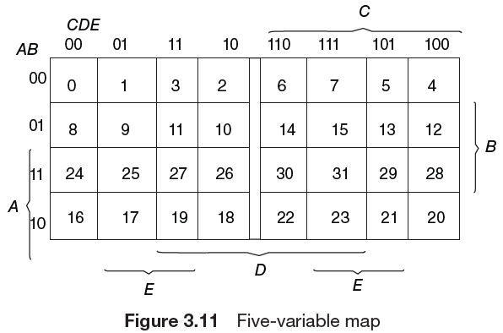
Why The Tabulation Method?
The map method of simplification is convenient as long as the number of variables does not exceed five or six.
As the number of variables increases, the excessive number of squares prevents a reasonable selection of adjacent squares.

Slide 3
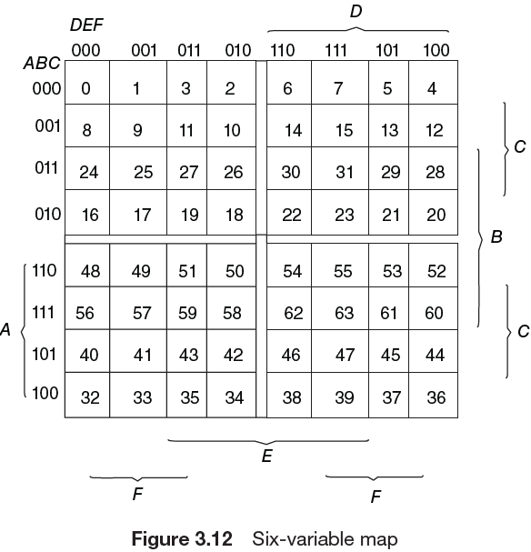
Why The Tabulation Method?
The obvious disadvantage of the map is that it is essentially a trial-and-error procedure which relies on the ability of the human user to recognize certain patterns.
For functions of six or more variables, it is difficult to be sure that the best selection has been made.

Slide 4
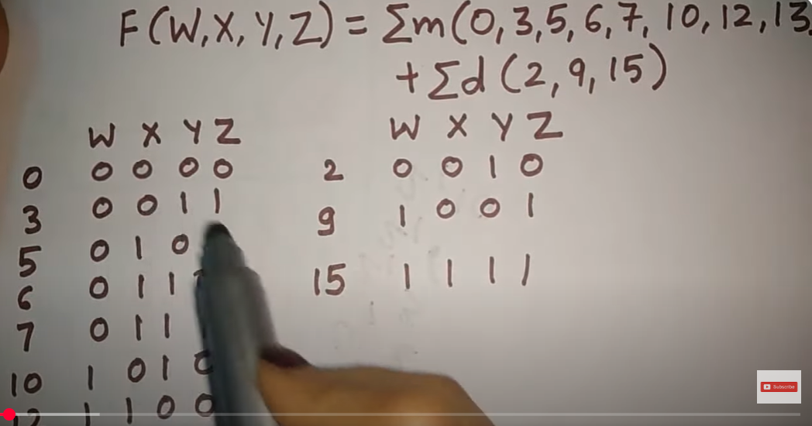
tabulation method with don't care condition | tabular method

Slide 5
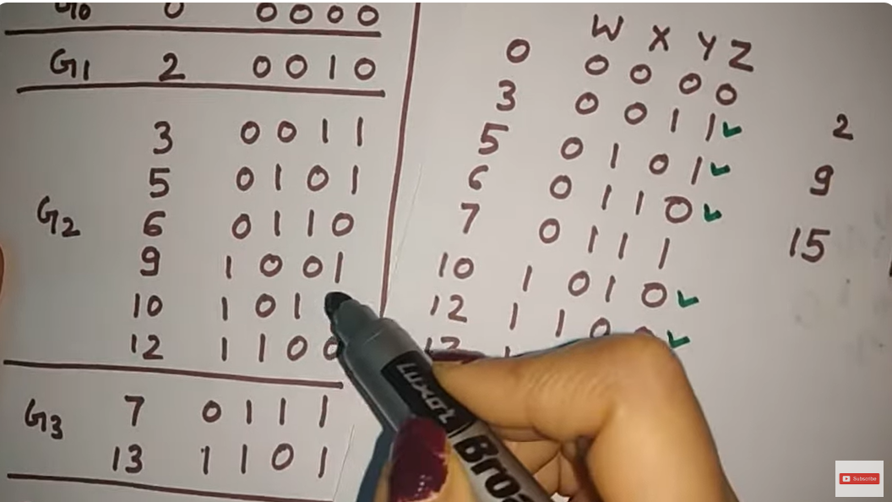
tabulation method with don't care condition | tabular method

Slide 6
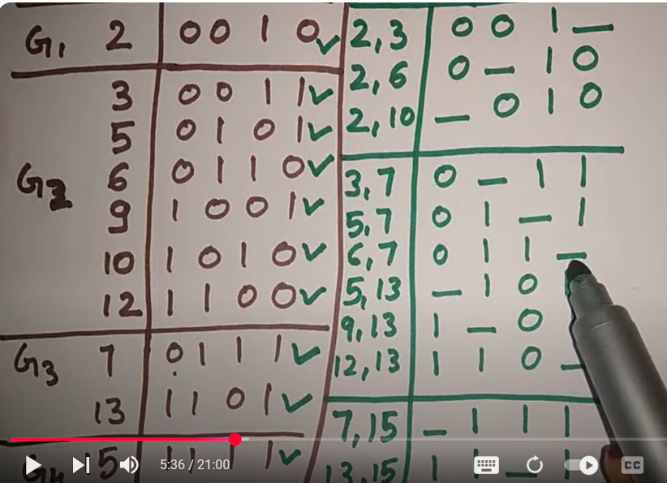
tabulation method with don't care condition | tabular method

Slide 7
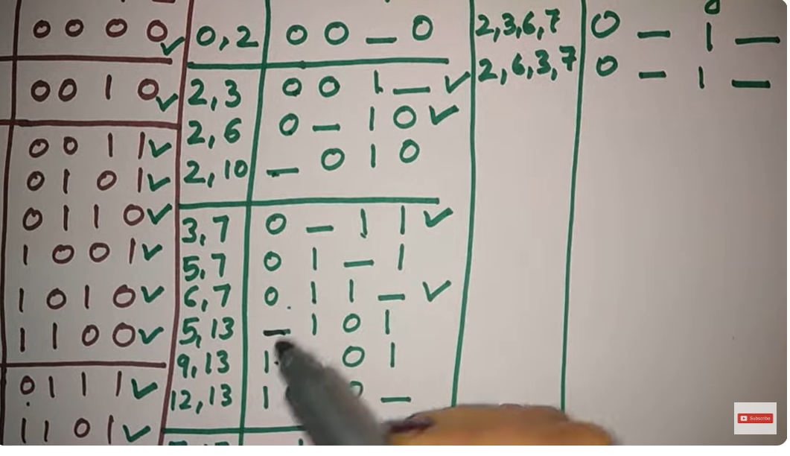
tabulation method with don't care condition | tabular method

Slide 8
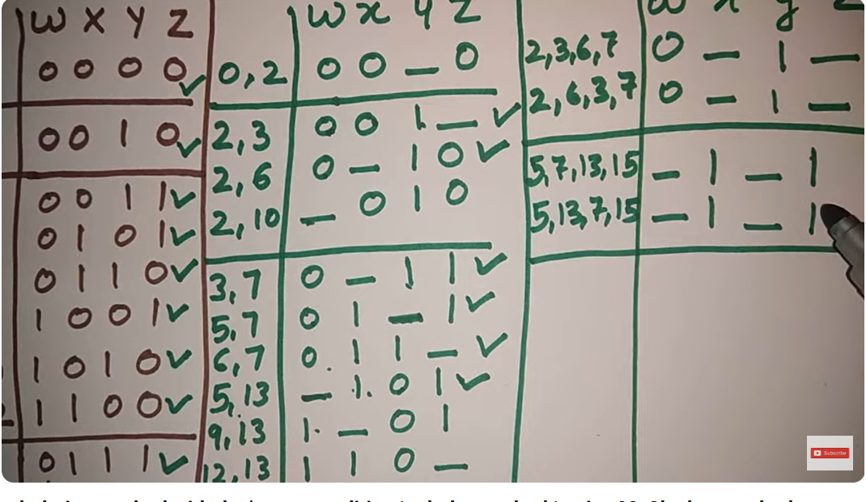
tabulation method with don't care condition | tabular method

Slide 9
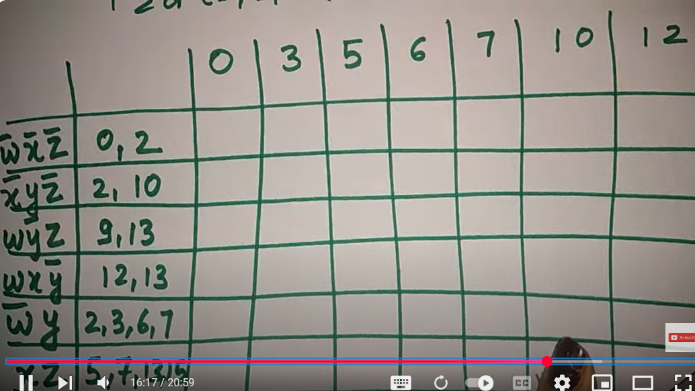
tabulation method with don't care condition | tabular method

Slide 10
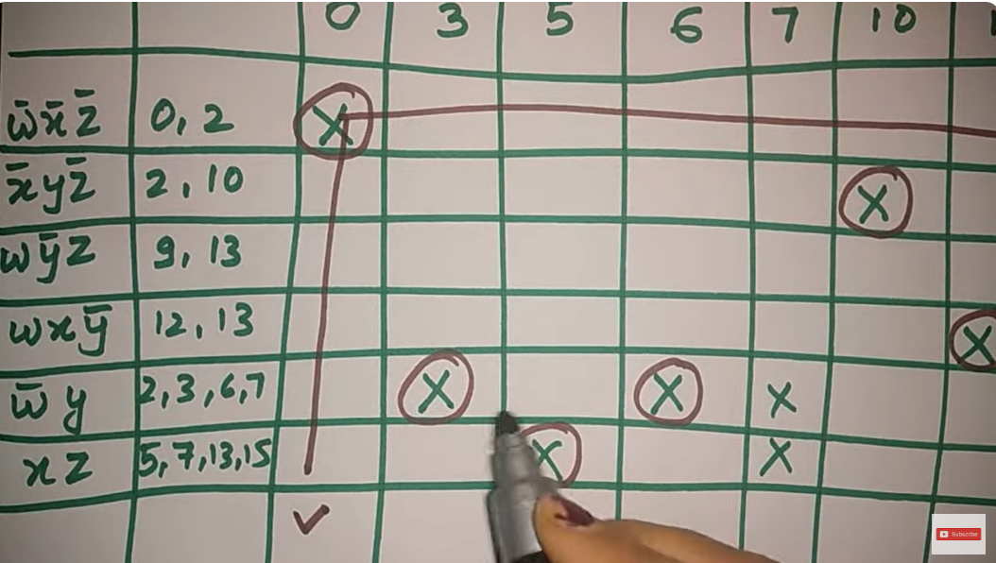
tabulation method with don't care condition | tabular method

Slide 11
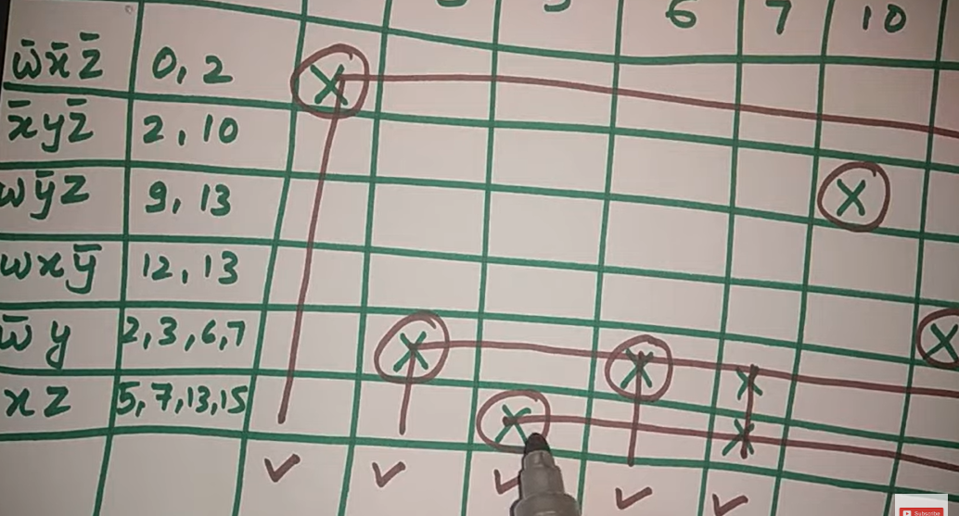
tabulation method with don't care condition | tabular method

Slide 12
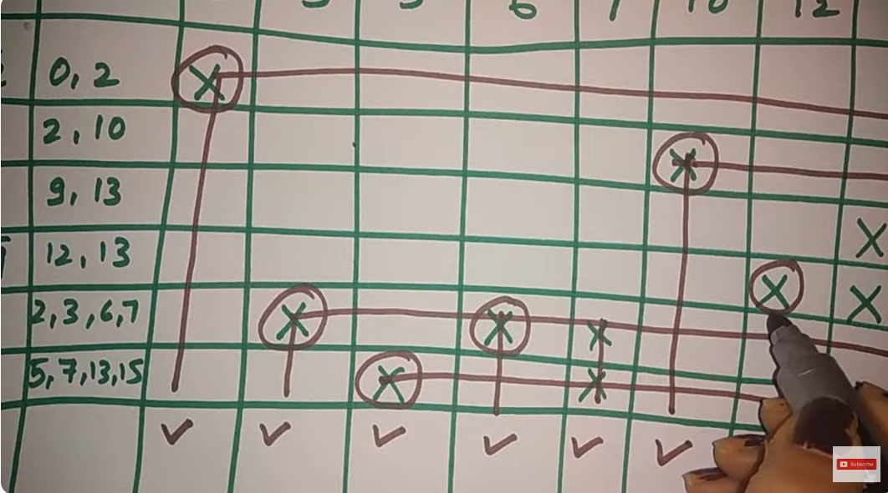
tabulation method with don't care condition | tabular method

Slide 13
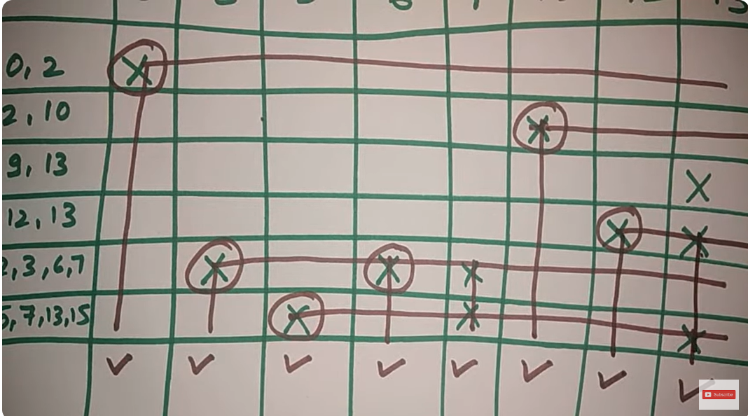
tabulation method with don't care condition | tabular method

Slide 14
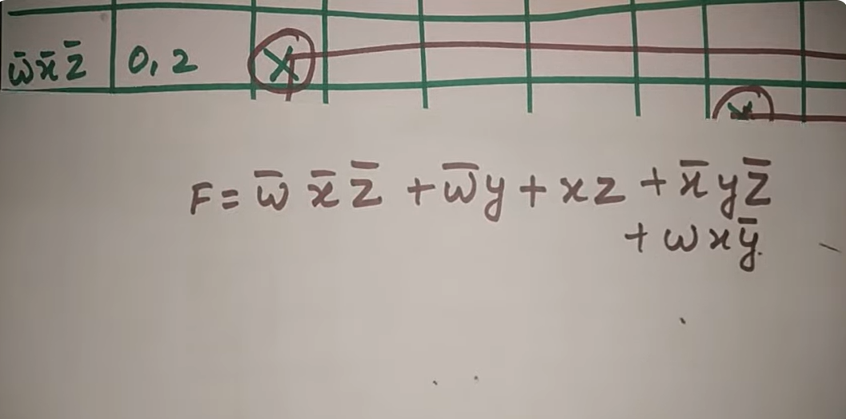
tabulation method with don't care condition | tabular method

Slide 15
https://www.youtube.com/watch?v=OR_YxeYZ6Ac.

Slide 16
F removal question solution (2021-2022)
Simplify the Boolean function using the Quine–McCluskey tabulation method: F = Σ(1, 4, 6, 8, 9, 11, 14) with don’t-care conditions d(A, B, C, D) = Σ(0, 3, 13)
Provide:
Prime implicant chart
Essential prime implicants
Final minimized SOP expression

Slide 17
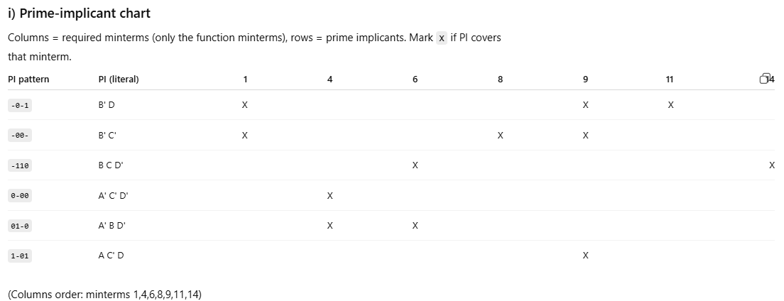

Slide 18

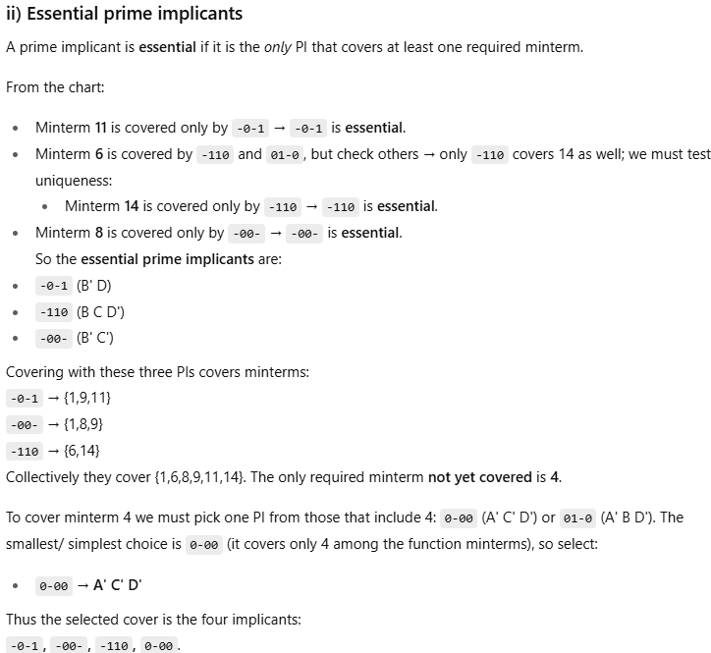

Slide 19
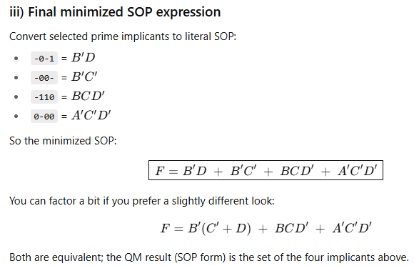

Slide 20
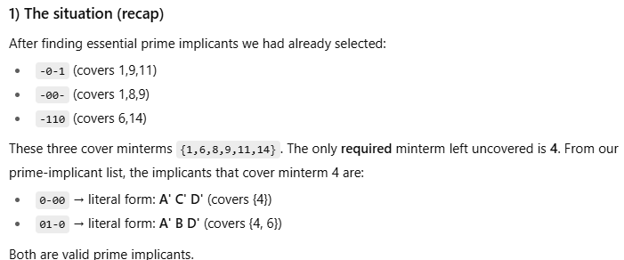
Why choose 0-00 (A' C' D')? Instead of A′BD′

Slide 21
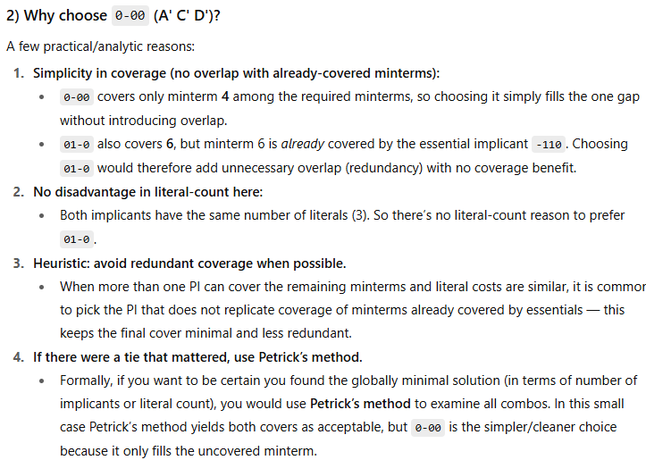
Why choose 0-00 (A' C' D')? Instead of A′BD′

Slide 22
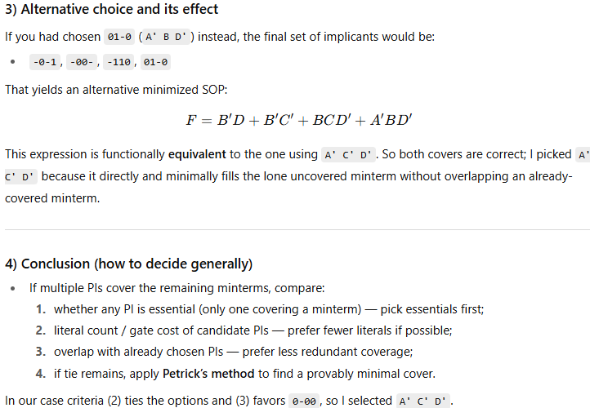
Why choose 0-00 (A' C' D')? Instead of A′BD′

Slide 23
89 page of book (pg 89-93)
3.9 The Tabulation Method
EXAMPLE 3-13: Simplify the following Boolean function by using the tabulation method: F = Σ(0, 1, 2, 8, 10, 11, 14, 15)

Slide 24
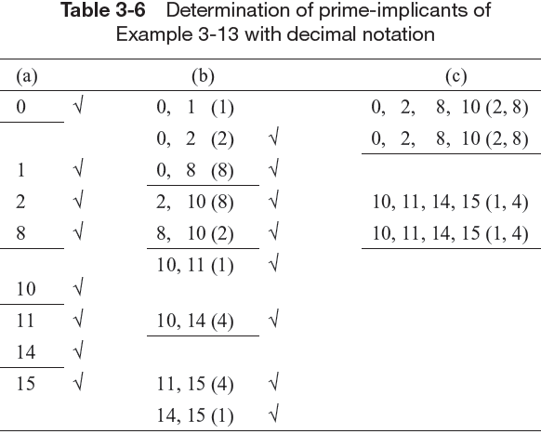
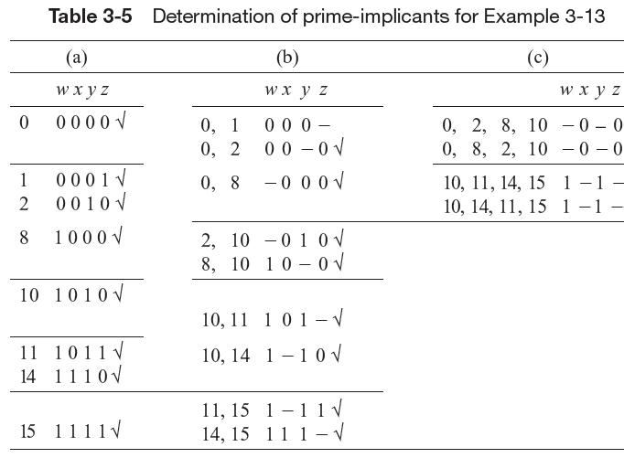
A comparison of Tables 3-5 and 3-6 may be helpful in understanding the derivations in Table 3-6.

Slide 25
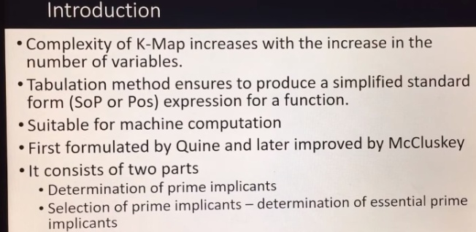

Slide 26
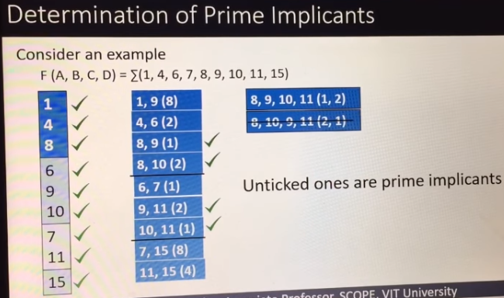

Slide 27
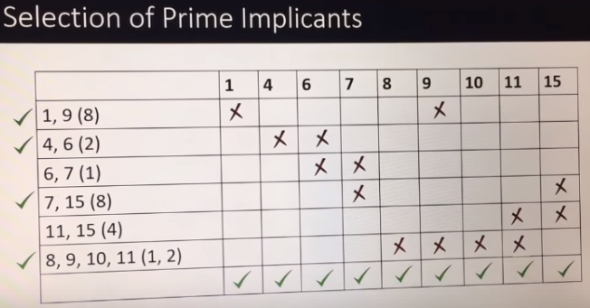

Slide 28
